Slide 1
Chapter 1
Introduction

Slide 2
Rendezvous Problem
Imagine a person trying to start two programs at the same time
on two separate computers
wanting them to communicate with each other

Slide 3
Rendezvous Problem—Client/Server
The client/server model solves the rendezvous problem by determining that one side (the server) must start execution, and wait indefinitely for the other side (the client) to contact it
Server
a program that waits for incoming communication requests from a client
When the server receives a communication from the client, the server provides some useful service to the client, and sends the client the results
Client
a program that initiates communication with the server
The client has need of some service that the server can provide

Slide 4
Client/Server
Clients are often easier to build than servers
commonly require no special system privileges
Servers often need to access data and/or routines or resources that are provided by an operating system and protected by the operating system
servers often need special system privileges

Slide 5
Client/Server (cont’d)
Servers are concerned with:
Authentication – verifying that the client is who it claims to be
Authorization – determining whether the given client is permitted to access any of the services the server supplies
Providing services
Data security – guaranteeing that a client is not allowed to access data that the client is not allowed to access, preventing data from being stolen

Slide 6
Client/Server (cont’d)
Servers typically come in two different versions:
Stateless – server does not save any information about the status of ongoing interaction with clients
Stateful – server saves information about the status of ongoing interactions with clients

Slide 7
What is Middleware?
According to Oracle (2016):
“Middleware is the software that connects software components or enterprise applications. Middleware is the software layer that lies between the operating system and the applications on each side of a distributed computer network. Typically, it supports complex, distributed business software applications.”

Slide 8
What is Middleware? (cont’d)
This definition is from Techopedia (2016) :
“Middleware is a software layer situated between applications and operating systems. Middleware is typically used in distributed systems where it simplifies software development by doing the following:
Hides the intricacies of distributed applications
Hides the heterogeneity of hardware, operating systems and protocols
Provides uniform and high-level interfaces used to make interoperable, reusable and portable applications
Provides a set of common services that minimizes duplication of efforts and enhances collaboration between applications”

Slide 9
What is Middleware? (cont’d)
This definition is from Apprenda (2016) :
“A simple middleware definition: software that connects computers and devices to other applications. It can also be referred to as the slash or connecting point in client/server. Another way to define middleware is to say that it is software that acts as a liaison between applications and networks. The term is often used in the context of cloud computing, such as public or private cloud.”

Slide 10
What is Middleware? (cont’d)
Middleware
is used to hide the lower level complexity of networks and operating systems from the application programmer
can allow a client running on one kind of computer with one kind of operating system to talk to a server on a different kind of computer running a different operating system
allows the definition of clearly defined interfaces to servers

Slide 11
Sockets (cont’d)—Socket Data Structures
To perform communication, sockets choose a family of protocols to use
which family to use is defined in the sockaddr struct
which is defined in the file “sys/socket.h”

Slide 12
Sockets (cont’d)—Socket Library Calls
Summary of main socket calls: Socket—creates a descriptor for use in network communications connect—connect to a remote peer (client) write—send outgoing data across a connection read—acquire incoming data from a connection close—terminate communication and deallocate a descriptor bind—bind a local IP address and protocol port to a socket listen—set the socket listening on the given address and port for connections from the client and set the number of incoming connections from a client (backlog) that will be allowed in the listen queue at any one time accept—accept the next incoming connection (server) | recv—receive the next incoming datagram recvmsg—receive the next incoming datagram (variation of recv) recvfrom—receive the next incoming datagram and record its source endpoint address send—send an outgoing datagram sendmsg—send an outgoing datagram (variation of send) sendto—send an outgoing datagram, usually to a prerecorded endpoint address shutdown—terminate a TCP connection in one or both directions getpeername—after a connection arrives, obtain the remote machine’s endpoint address from a socket getsockopt—obtain the current options for a socket setsockopt—change the options for a socket

Slide 13
Sockets (cont’d)—Socket Library Calls
write()—writes to an operating system buffer, and blocks when the buffer is full
When read() is used with the TCP/IP protocol, it extracts bytes and copies them to user’s buffer. It blocks if there is no input data. When there is data, it fills the receiving buffer, then stops.
When read() is used with the UDP protocol, it extracts one incoming UDP message. If the buffer cannot hold the entire message, read() fills the buffer and discards all remaining data in the UDP message
Note that you can also use a recv instead of a read, and you could also do recvmsg, recvfrom, sendmsg, sendto. These would allow you to send a message without waiting for a response to tell whether the message was received by the other side or not
This is datagram type operation

Slide 14
Sidebar Big Endian vs. Little Endian
Let’s choose the number 70A32C17 base 16, and assume it is stored starting at byte address 100.
In big endian this would be stored as follows:
100: 70
101: A3
102: 2C
103: 17
whereas in little endian this would be stored as follows:
100: 17
101: 2C
102: A3
103: 70

Slide 15
Network Byte Order with Sockets
Network byte order—a standard representation specifies a standard representation for binary integers in protocol headers in TCP/IP
specifies integers with the most significant byte first (big endian).

Slide 16
Network Byte Order with Sockets
socket routines include several functions that convert integers between network byte order and the local host’s byte order
programs must explicitly call the conversion routines
and always should call them, even when not necessary, for portability
Short conversion routines – operate on 16 bit integers (unsigned):
Host to network short (htons)
Network to host short (ntohs)
Long conversion routines – operate on 32 bit integers (unsigned):
Host to network long (htonl)
Network to host long (ntohl)

Slide 17
What are Remote Procedure Calls?
The first attempts at middleware were things like sockets and Open Network Computing (ONC) Remote Procedure Calls (RPCs)
With Remote Procedure Calls (such as ONC RPC), the idea is that you treat a call across the network the same as you would treat a call to a local procedure

Slide 18
What are Remote Procedure Calls?
RPCs are functionally-oriented because they came along before the object-oriented paradigm was widely used in industry
Functionally-oriented means they focused on procedure calls—data was separate
Note, however, that how various technologies that employ Distributed Objects work is often also called, in a generic way, a remote procedure call

Slide 19
Synchronous vs. Asynchronous
In synchronous communication
the client calls the server
then the client blocks and waits for the server to finish
In asynchronous communication
the client calls the server
instead of blocking and waiting for the server’s response, it goes on about its business

Slide 20
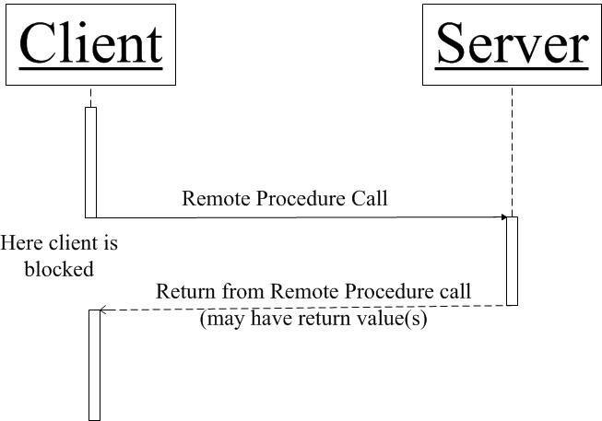
Synchronous vs. Asynchronous (cont’d)—Synchronous

Slide 21
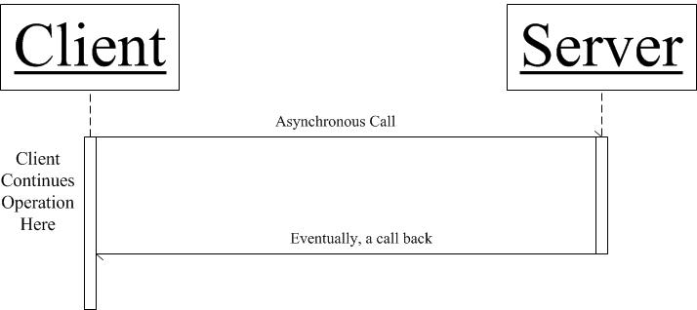
Synchronous vs. Asynchronous (cont’d)—Asynchronous—Callback Version

Slide 22
What are Distributed Object-Oriented Components?
In the object-oriented paradigm, of course data and procedure calls are encapsulated inside an object
So distributed objects just refer to objects that are located on different computers

Slide 23
What are Distributed Object-Oriented Components?
Generally speaking,component-based software engineering consists of combining loosely coupled components into systems

Slide 24
What are Distributed Object-Oriented Components?
There have been arguments about whether there is, in fact, a difference between component-based systems and object-oriented systems
objects in an object-oriented system focus on modeling real world situations
components in a component-based system are focused solely on combining existing components into systems
but where do the existing components come from in the first place goes the other argument

Slide 25
What are Distributed Object-Oriented Components?
Gomaa (2011) defines a distributed component as follows:
“a distributed component is a concurrent object with a well-defined interface, which is a logical unit of distribution and deployment. A well-designed component is capable of being reused in applications other than the one for which it was originally developed.”

Slide 26
What is Message Oriented Middleware?
Message oriented middleware (MOM)
purpose is to provide a middleman in between the client and the server
may do additional processing, perhaps Quality of Service-type processing
the client talks to the middleman
the server talks to the middleman,
the client doesn’t have to talk directly to the server
the server doesn’t have to talk directly to the client.
nearly always uses a message queue to store messages between message producer and message consumer
asynchronous

Slide 27
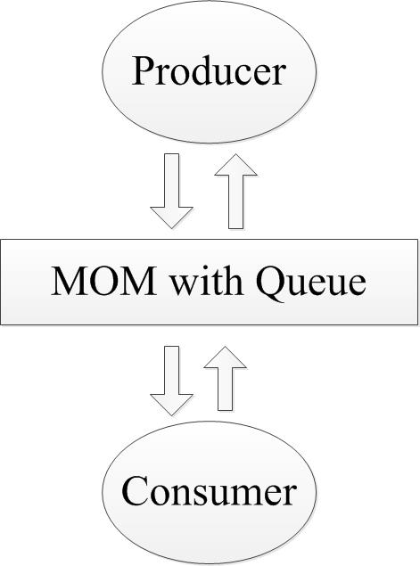
What is Message Oriented Middleware? (cont’d)

Slide 28
What are Service Oriented Architectures?
According to the Open Group a Service Oriented Architecture (SOA) is an architectural style that supports service orientation
Service orientation is a way of thinking in terms of the outcomes of services, and how they can be developed and combined
a service is a repeatable business activity that can be logically represented, the Open Group gives the example: “check customer credit”
a service is self-contained
a service may be composed of other services
consumers of the service treat the service as a black box

Slide 29
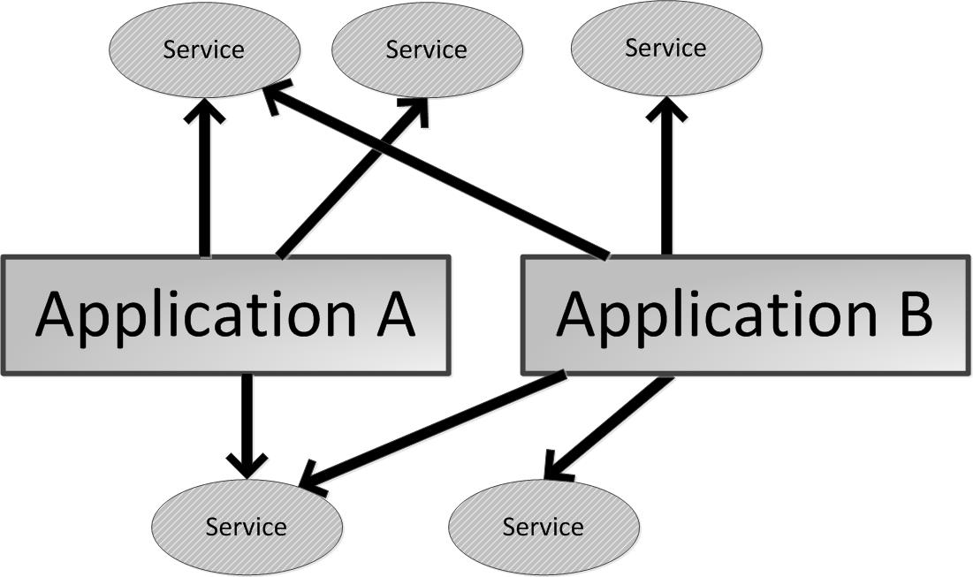
What are Service Oriented Architectures? (cont’d)

Slide 30
What are Service Oriented Architectures? (cont’d)
Services may be located on different computers
Each service has a well defined, well documented interface
Services are independent and may be reused by different applications
Services are loosely coupled with any of the calling applications
It is common to implement service oriented architectures with web services
It is possible to alternately use other implementations, such as distributed object components

Slide 31
What are Web Services?
Web services are applications that typically expect to make use of the world wide web to provide application services
We distinguish the “world wide web” from the “internet” The internet is connected using the TCP/IP protocols
The world wide web is a collection of information in the form of web pages, that are connected using hypertext (clickable) links

Slide 32
What are Web Services? (cont’d)
There are two kinds (architectural styles) of technologies that are commonly used for web services:
non-RESTful web services implemented with WSDL and SOAP technologies that treat HTTP as an independent lower protocol layer
the RESTful web services that use HTTP directly

Slide 33
What is Cloud Computing?
IBM (2016) defines cloud computing as follows:
“Cloud computing, often referred to as simply “the cloud,” is the delivery of on-demand computing resources—everything from applications to data centers—over the Internet on a pay-for-use basis.”
Applications running on the cloud often employ a service oriented architecture

Slide 34
What is Cloud Computing?
Public cloud:
instead of doing your own computing and storing your data on the computer on your desktop yourself
you hire a company to do the computing and store the data on their big computer servers that you access via the web
Private cloud:
instead of having computing and data storage on employees’ desks
the company can buy its own big servers
then the employees do their computing and store their data on those servers
Hybrid cloud:
Part of a company’s computing is done in house
Part of a company’s computing is done by a public cloud

Slide 35
What is Cloud Computing?
There are three different paradigms for cloud computing:
Infrastructure as a Service (IaaS)
you or your company pays a cloud provider for computing resources
You provide your own operating system and application software
Platform as a Service (PaaS)
you or your company pays a cloud provider for an environment provided by the company that provides everything you need in order to develop and run your applications
This environment includes operating system, development tools, web site hosting, among other things
Software as a Service (SaaS)
you or your company pays a cloud provider for the use of their software application

